Slide 1
Can Metro Mayors help in Tackling Workplace Discrimination?
Promoting Fairness at Work
Creating an Inclusive Economy

Slide 2
Liverpool City Region
Fairness, Inclusivity, Justice
Why Metro Mayors should be concerned about Discrimination at Work
Where this fits with wider policies
What’s Happening around the country
Where we are up to in Liverpool City Region
Future opportunities and challenges

Slide 3
Why Metro Mayors should be concerned about Discrimination at Work

Slide 4
Notes:
These are new Index of Multiple Deprivation maps – just highlighting spatially the deep rooted issues across the City Region, and the next slide showing the difference between 2015 and 2019 – but in effect, the issues have been entrenched and exacerbated across many decades.

Slide 5
Notes:
Red shows where areas have got worse, blue where improvement since 2015. Key messages are that improvement in LCR is lagging behind other areas of the country. National picture is that many urban have seen increases in relative deprivation, whilst London and rural areas have seen the greatest decreases and are less deprived now compared to 2015.

Slide 6
Inactivity is underpinned by complex health-related challenges
Male Life Expectancy at Birth (2018)
Source: Public Health England
Prevalence of Common Mental Health Disorders (2018)
Source: Public Health England
1 Health for Wealth: Building a Healthier Northern Powerhouse for UK Productivity

Slide 7
Those in work need upskilling
We have a low proportion of highly skilled workers (NVQ4+), and a high proportion of residents with no qualifications.
A highly skilled population is a key component of a competitive, productive economy.
Qualification levels of the Working Age Population (2018)
Source: Annual Population Survey

Slide 8
Where this fits with wider policies

Slide 9
Where we started - Manifesto Commitment……
Rewarding and promoting fair and ethical business
“We will establish a City Region Fair Employment Charter that recognises and celebrates businesses that promote social value by paying the Real Living Wage, minimising the use of ‘zero hours’ contracts, recognising and working with trades unions, procuring locally where possible, engaging with the social economy, providing quality apprenticeships, investing in their workforce and promoting gender equality.”

Slide 10
How this fits with wider LCRCA work
LCR Growth strategy says……
“Whilst the focus of the strategy is economic growth, it is important to remember that economic growth is not, in itself, an end . Its is rather the key factor in ensuring that all of our residents have the opportunity for a decent quality of life for themselves and for their children and for their children's children.”

Slide 11
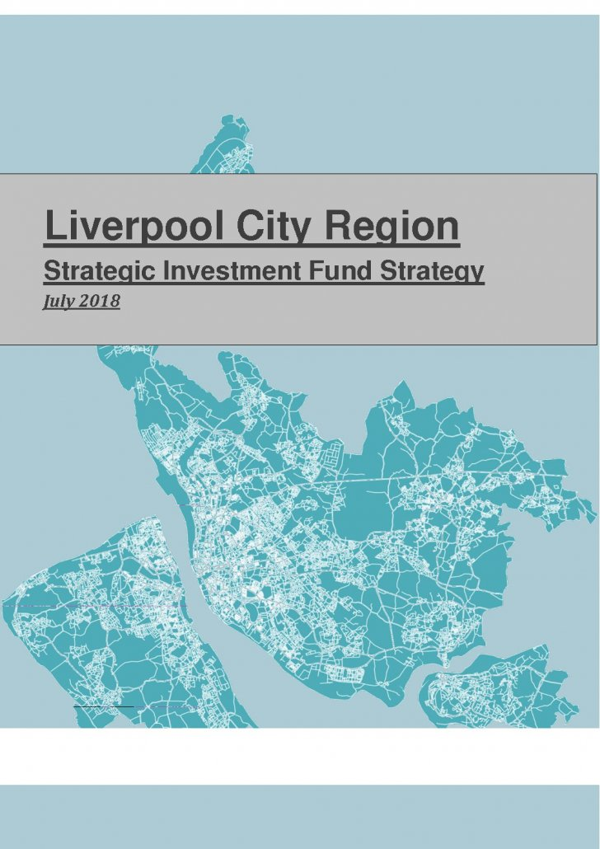
How this fits with wider LCRCA work
Strategic Investment Fund Strategy says ….
“A project’s potential to generate inclusive growth and social value will become part of our appraisal criterion committing public money “
“The kinds of investments we will make to deliver inclusive growth and reduce inequality include:-
- Projects which support the creation of good quality jobs (including paying the real living wage”
“The investment team will request that the project sponsor complete an inclusive growth, social value and diversity questionnaire”

Slide 12
How this fits with wider LCRCA work
Local Industrial Strategy Position statement says ….
“There are a range of further initiatives being delivered to support people across the City Region. This includes the Ways to Work Programme that enhances employability and skills and the Households into Work programme which supports disadvantaged people who face multiple employability barriers. There is a recently launched ‘one stop’ apprenticeship portal; and a newly devolved Adult Education Budget which provides the opportunity of tailoring the adult education system to better address local priorities. We are delivering a Housing First Pilot which provides permanent housing for homeless people. Our Fair Employment Charter is also the beginning of a new, socially focused
conversation with our business base.”

Slide 13
What’s Happening around the country

Slide 14
What’s happening elsewhere
Who Else is talking about Good Employment ?
Chambers of Commerce
Blueprint for Better Business / Be The Business
Engaging Works
British Retail Consortium
Charter Led organisations

Slide 15
What's Happening elsewhere
Who has developed Employment Charters ?
Birmingham Business Charter for Social responsibility
Croydon Good Employment Charter
Oldham Fair Employment Charter
Salford City Mayor’s Charter for Employment Standards
Scottish Business Pledge
Worcestershire Charter for Inclusive Growth

Slide 16

What’s happening elsewhere
Combined Authorities
GM – Good Employment Charter
  Co-designed
  Wide consultation before drafting
  Tiered approach - encouraging progress
  Utilises existing accreditation schemes
  Draft to be issued for further consultation

Slide 17
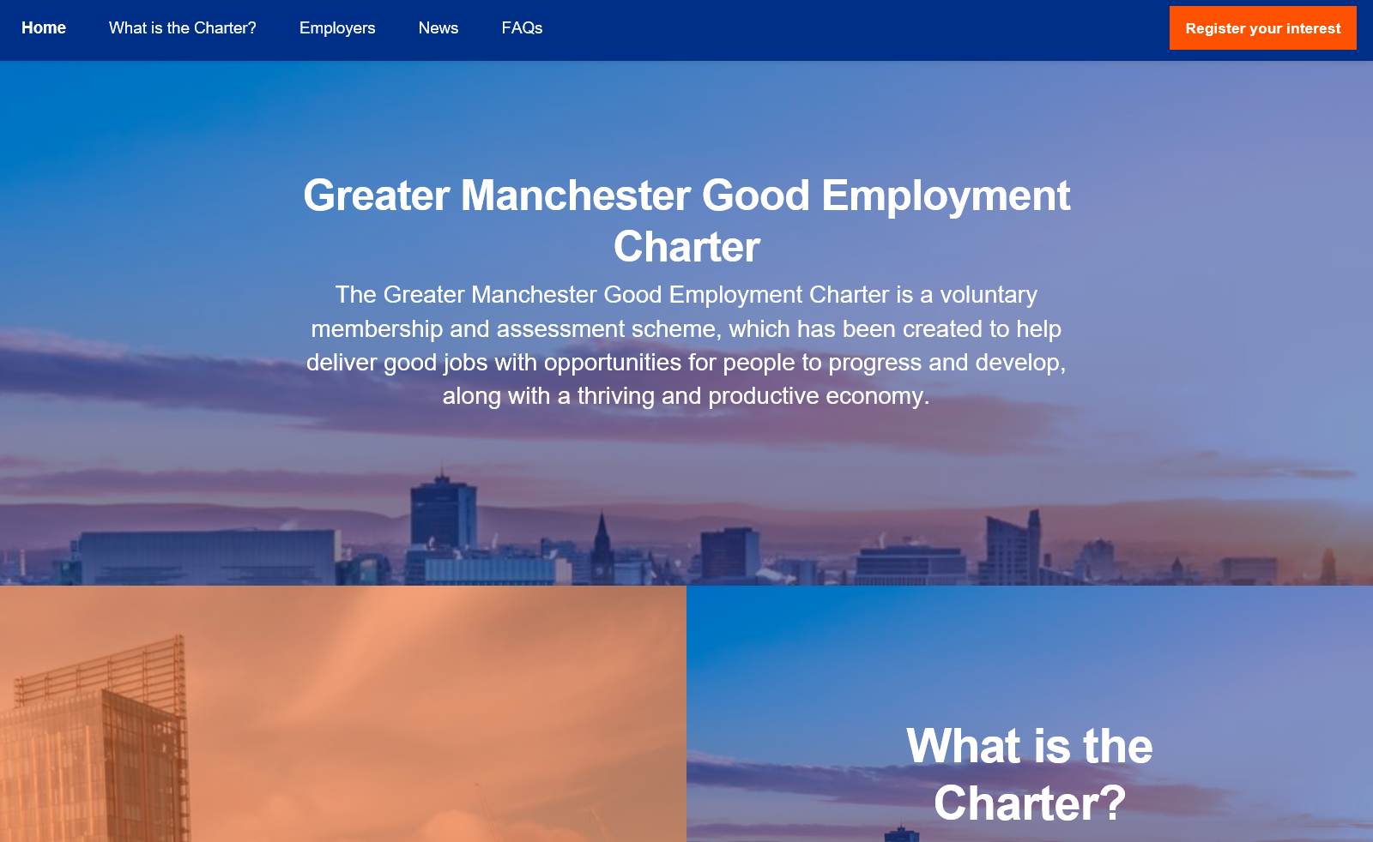

Slide 18
What’s happening elsewhere
Combined Authorities
London Mayor’s Good Work standard
  5 strands drawing together London Living Wage with existing programmes/strategies
  On-line platform with a self-assessment/diagnostic tool - £500k budget
  Targeted face-to-face support
  Promotes accreditation partners - provide support/delivery
  Must do, should do, could do
  Leading by example – e.g. publishing ethnicity pay gap audit

Slide 19
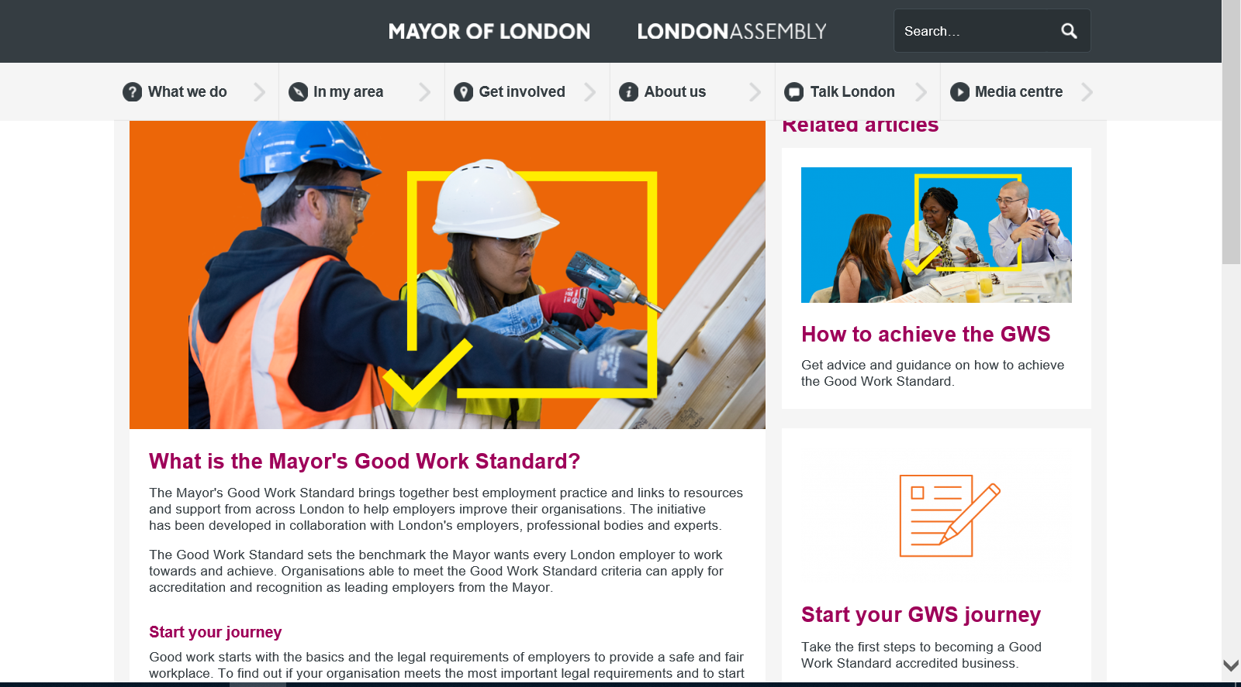

Slide 20
What’s happening elsewhere
Combined Authorities
North of Tyne Combined Authority
  Work starting in the autumn using advice from GM

Slide 21
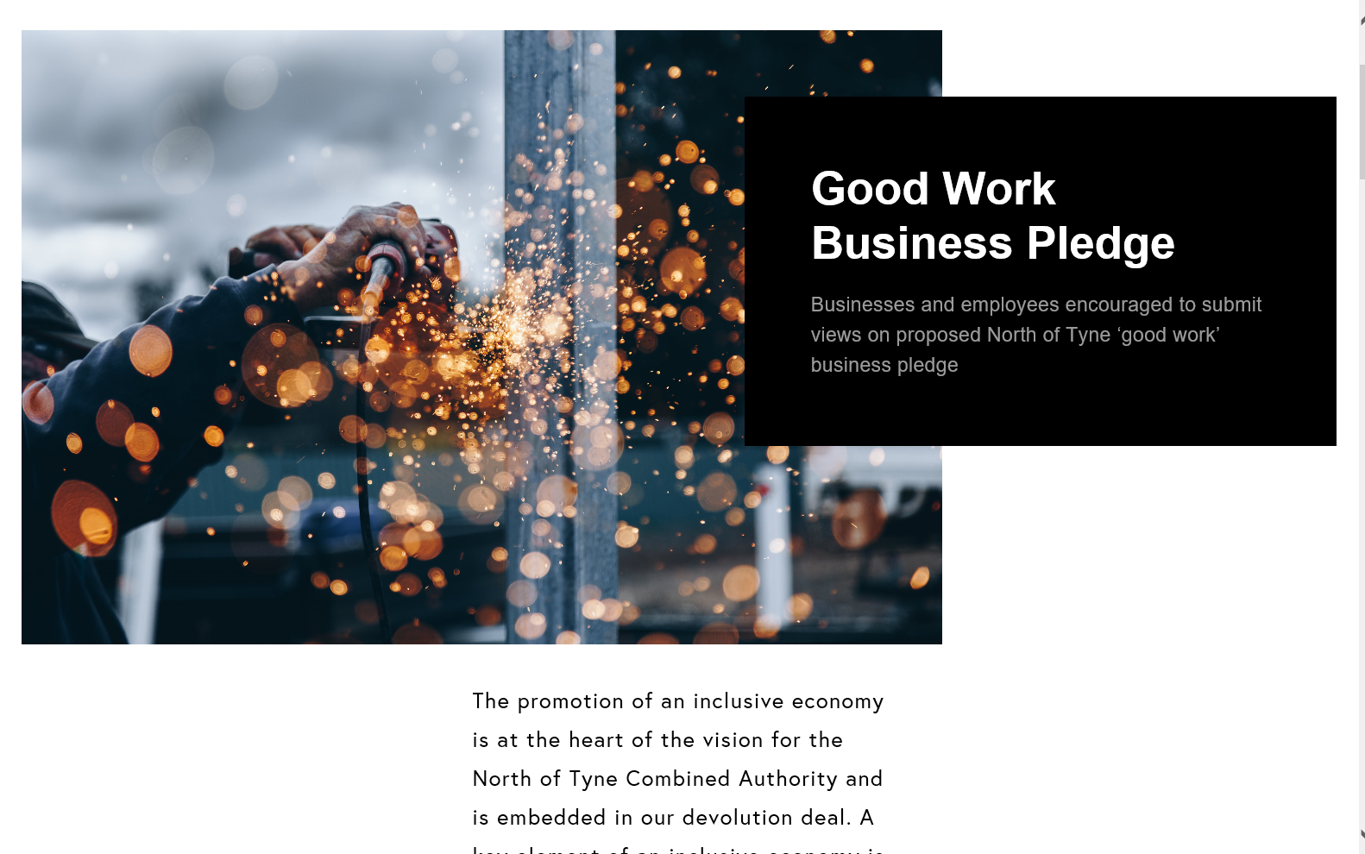

Slide 22
Where we are up to ?

Slide 23
Why should LCR develop a charter?
To drive Inclusive Growth and support a Local Industrial Strategy
  JRF evidence on tackling the long tail of low productivity
  Pay and engagement widely acknowledged as the two strongest drivers of productivity in the retail sector
  Living wage evidence on staff retention and willingness to develop skills at work
To support the CA’s commitment to Fairness and Social Justice
  Key elements of a charter would cover Equality and Diversity at work
To tackle key priority of developing skills to match jobs
  Lifelong learning and access to training would be at the core

Slide 24
First stage consultation
January – March 2019
Over 60 responses
Priority themes:-
  Inclusivity
  Paying the real living wage
  Employee voice at work
  Good Flexible working (work/life balance) not bad flexible working (zero hours contracts)
  Continuous training and development
  Health and Wellbeing

Slide 25
What work has already been done ?
Many LCR Employers will already have accreditations including :-
  Living Wage Foundation
  Ethical Care Charter
  Investors in People
  Working Forward Pledge
  Disability Confident Scheme
  Workplace wellbeing Charter
  Dying to Work Charter
  Liverpool Construction Standards Charter

Slide 26
Comments included …..
Equitable work packages that recognises diversity in a workforce (differences in health needs, care responsibilities, gender, age, location and transport, other influences that affect a persons life).
Embracing workplace democracy: The Charter needs to encourage a meaningful understanding of the importance of employee/professional voice with a default position of recognising appropriate trade unions for the

Slide 27
Comments included ….
Paying the real living wage to their employees and supply chain; having a pay multiplier no higher than 5 times that of the lowest remunerated to the highest. Recognising trade unions and working with them in
Equity for women, BAME and those with disabilities; Flexible working hours; Alternative work contracts for parents with young and school age children; More support for those with school age children.

Slide 28
Comments included…..
Fair pay engaging with staff - employee voice flexibility to meet work and home life challenges
A good employer pays the living wage; develops their staff; is clear about standards, expectations and values and engages civically with those less fortunate

Slide 29
Comments included…..
Trains staff, provides opportunities for local people through apprenticeships, work experience placements etc., provides health & well-being services for existing staff, promotes equality of employment
To have a diverse workforce, pays the living wage, is disability confident and willing to recruit candidates from 'disadvantaged groups' from across the City Region

Slide 30
What would a LCR Fair Employer look like?
A Fair employer – who pays the real living wage , gives people security of their hours of work
An Inclusive employer…..who ensures equality of opportunity from recruitment through to access to lifelong learning ….lets people balance work and life, creates a healthy and inclusive workplace
A Just employer…who gives people a voice at work , gives young people a chance of a good apprenticeship, trains managers to ensure consistency of practice

Slide 31
Next Steps ?
Reference Group now established
Internal delivery group established
Deputy portfolio lead identified within CA
Liaison with other areas developing work

Slide 32
Future opportunities and challenges

Slide 33
Challenges
Same as other CAs but with an LCR feel to it
Setting the bar at the right level
Encouraging employers to improve rather than reward where they stand
What about start ups and new businesses?
Resources and timescales

